Slide 1

Project Title: A Tool for Lecture Assessment as per OBE policy
DEPARTMENT OF COMPUTER SCIENCE
Project Mentor
Dr Akash Punhani
Team Members-
Pallavi Sharma (2200290120116)
Saksham (2200290120143)

Slide 2
Problem Statement
In Outcome-Based Education (OBE) environments, measuring student engagement and understanding after each lecture is crucial. Traditional methods, such as oral questioning, often result in limited student participation and fail to provide comprehensive insights into learning outcomes. Although ICT tools have been introduced to automate assessments, they typically require expensive infrastructure, stable internet connectivity, and are susceptible to misuse through AI-generated answers. Additionally, time-bound quizzes conducted via digital platforms can create network-related challenges, further hindering their effectiveness. These limitations highlight the need for a low-cost, practical, and reliable solution that enables real-time, fair, and efficient assessment of lecture comprehension without dependency on complex computing systems or the internet.

Slide 3
Introduction
Active student participation is essential for achieving the objectives of any lecture. Traditionally, this participation is measured by asking questions during class and evaluating student responses. However, this method often results in limited engagement, targeting only specific students and failing to accurately assess how many have understood the material. To address this, Information and Communication Technology (ICT) tools were introduced in classrooms. These tools require computing systems and internet or intranet connections to function, leading to increased infrastructure costs. Additionally, with the rise of AI tools, students can easily generate answers, undermining the effectiveness of these systems. To counteract this, educators have tried time-limited multiple-choice quizzes, which create a sense of urgency but can introduce technical issues like network failures during assessments. This paper proposes an alternative solution—a simple, low-cost device that minimizes such challenges. It enables effective quiz-based evaluation after each lecture without relying on complex infrastructure or internet connectivity. The device aims to improve classroom interaction, ensure fair participation, and accurately measure lecture outcomes in a practical, cost-effective manner. The following sections explore how this tool can serve as a reliable and scalable method for enhancing student engagement and learning assessment.

Slide 4


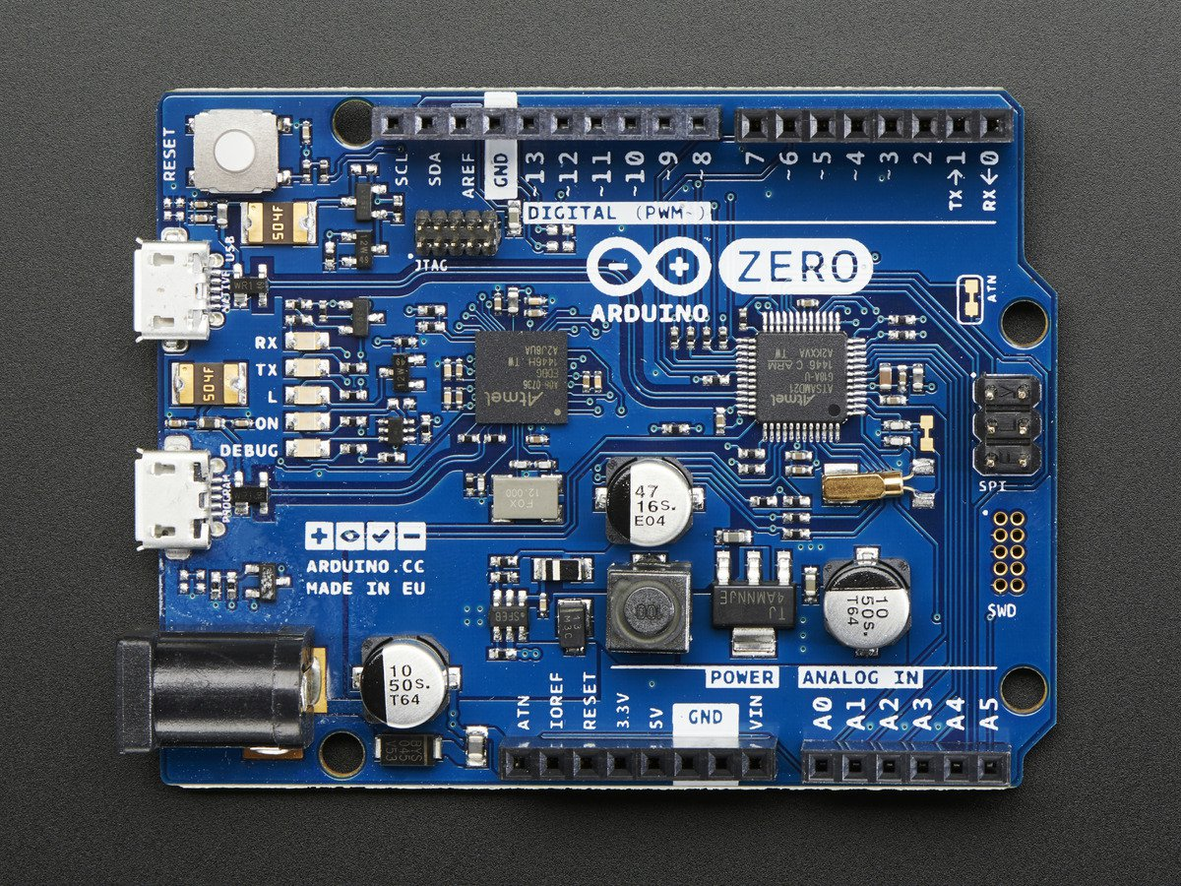

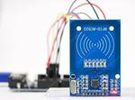
Technology Used
Frontend
React.js
Backend
Node.js
Database
MongoDb
IOT
RFID
Arduino

Slide 5
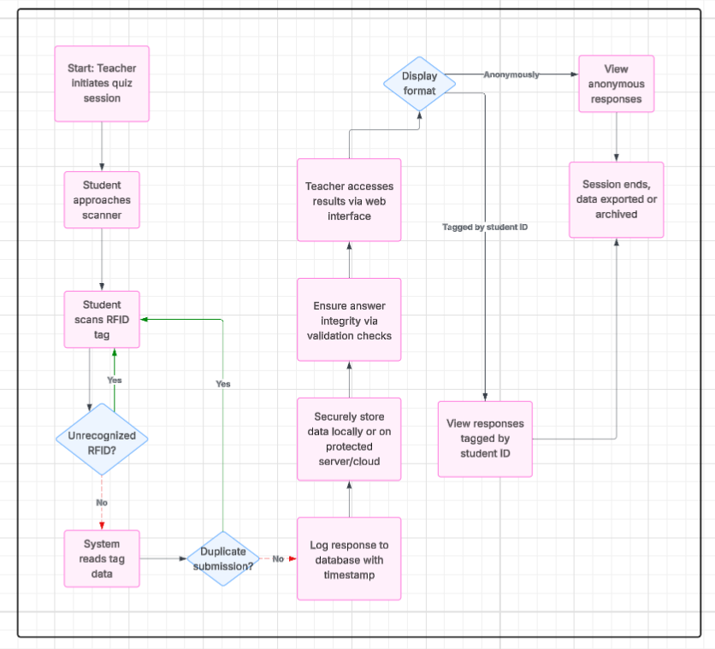
Flowchart

Slide 6
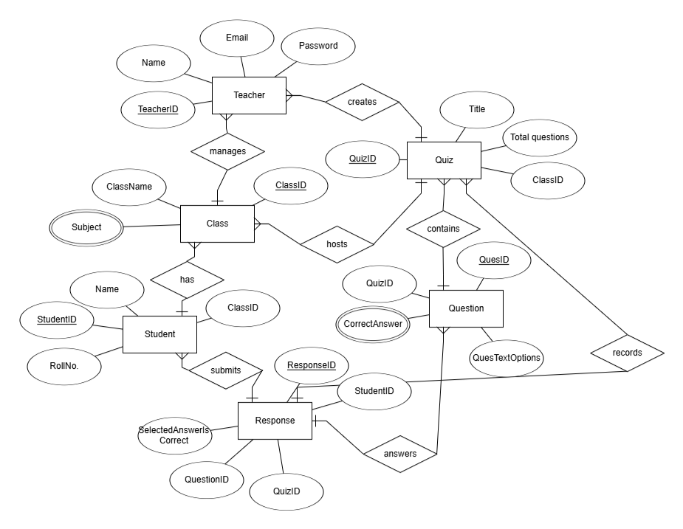
ER Diagram

Slide 7
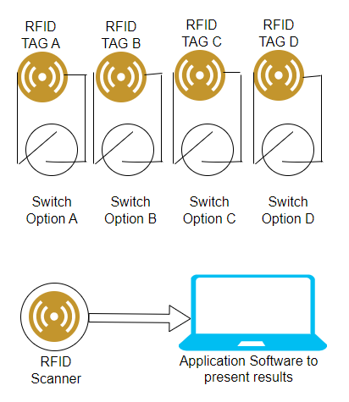
Project Prototype

Slide 8
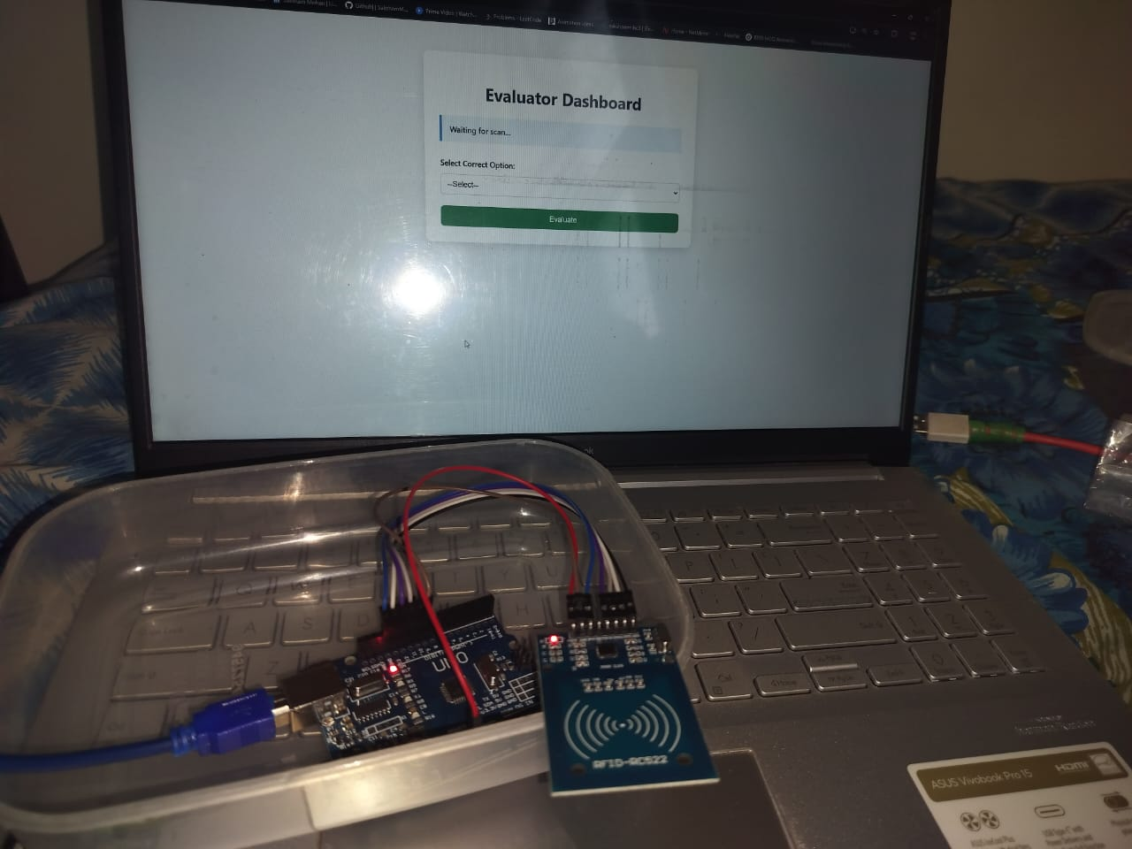
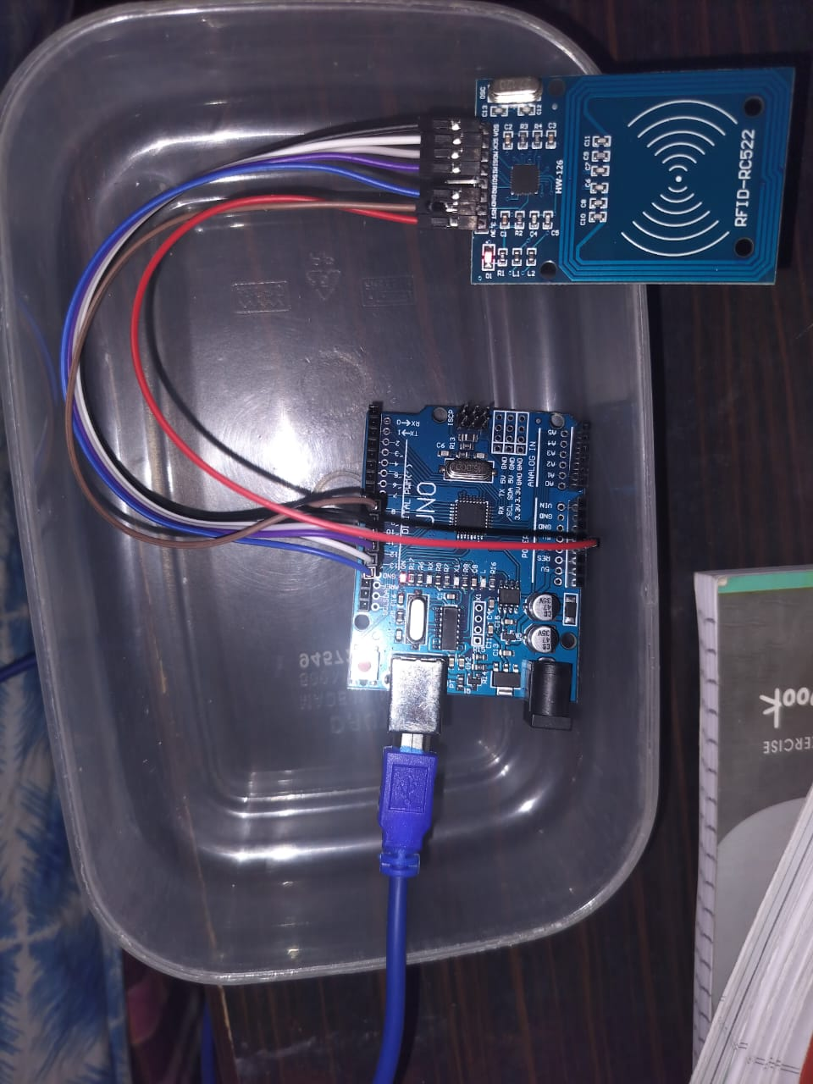
Project Prototype

Slide 9
Project Status
Github Link:
https://github.com/SakshamMohan18/Major-Project.git

Slide 10
Patent Status
Drafted the patent

Slide 11
Research Paper Status

